Slide 1

HR
Analytics

Slide 2

W
E
L
C
O
M
E
W
E
L
C
O
M
E
W
E
L
C
O
M
E
W
E
L
C
O
M
E
W
E
L
C
O
M
E
O
W
E
L
C
O
M
E
W
E
L
C
O
M
E

Slide 3
W
E
L
C
O
M
E
O
W
E
L
C
O
M
E
W
E
L
C
O
M
E
W
E
L
C
O
M
E
W
E
L
C
O
M
E
W
E
L
C
O
M
E
HR
Analytics
W
E
L
C
O
M
E

Slide 4

HR
Analytics
Project Objective
The goal of this project is to
analyze the HR to Identify factors affecting employee
Measure employee satisfaction
Measure employee performance

Slide 5
HR
Analytics
Business Questions
What is the most common department for employees who left the company?
What is the correlation between salary and attrition?
What is the correlation between years of experience and attrition?
What is the correlation between education level and attrition?
What is the difference in attrition rates between men and women?
What is the difference in attrition rates between different departments?
What is the difference in attrition rates between different salary ranges?

Slide 6
HR
Analytics
Project steps
Data Exploration
Data Cleaning
Data Modeling
Data Analysis
Data Exploration:- We have 5 tables containing our HR data
Data Cleaning:- Fixing or removing incorrect, corrupted, incorrectly formatted, duplicate, or incomplete data within a dataset
Table Name | Type
Education Level | (Dim Table)
Employee | (Dim Table)
Rating Level | (Dim Table)
Satisfied level | (Dim Table)
Performance Rating | (Fact Table)

Slide 7




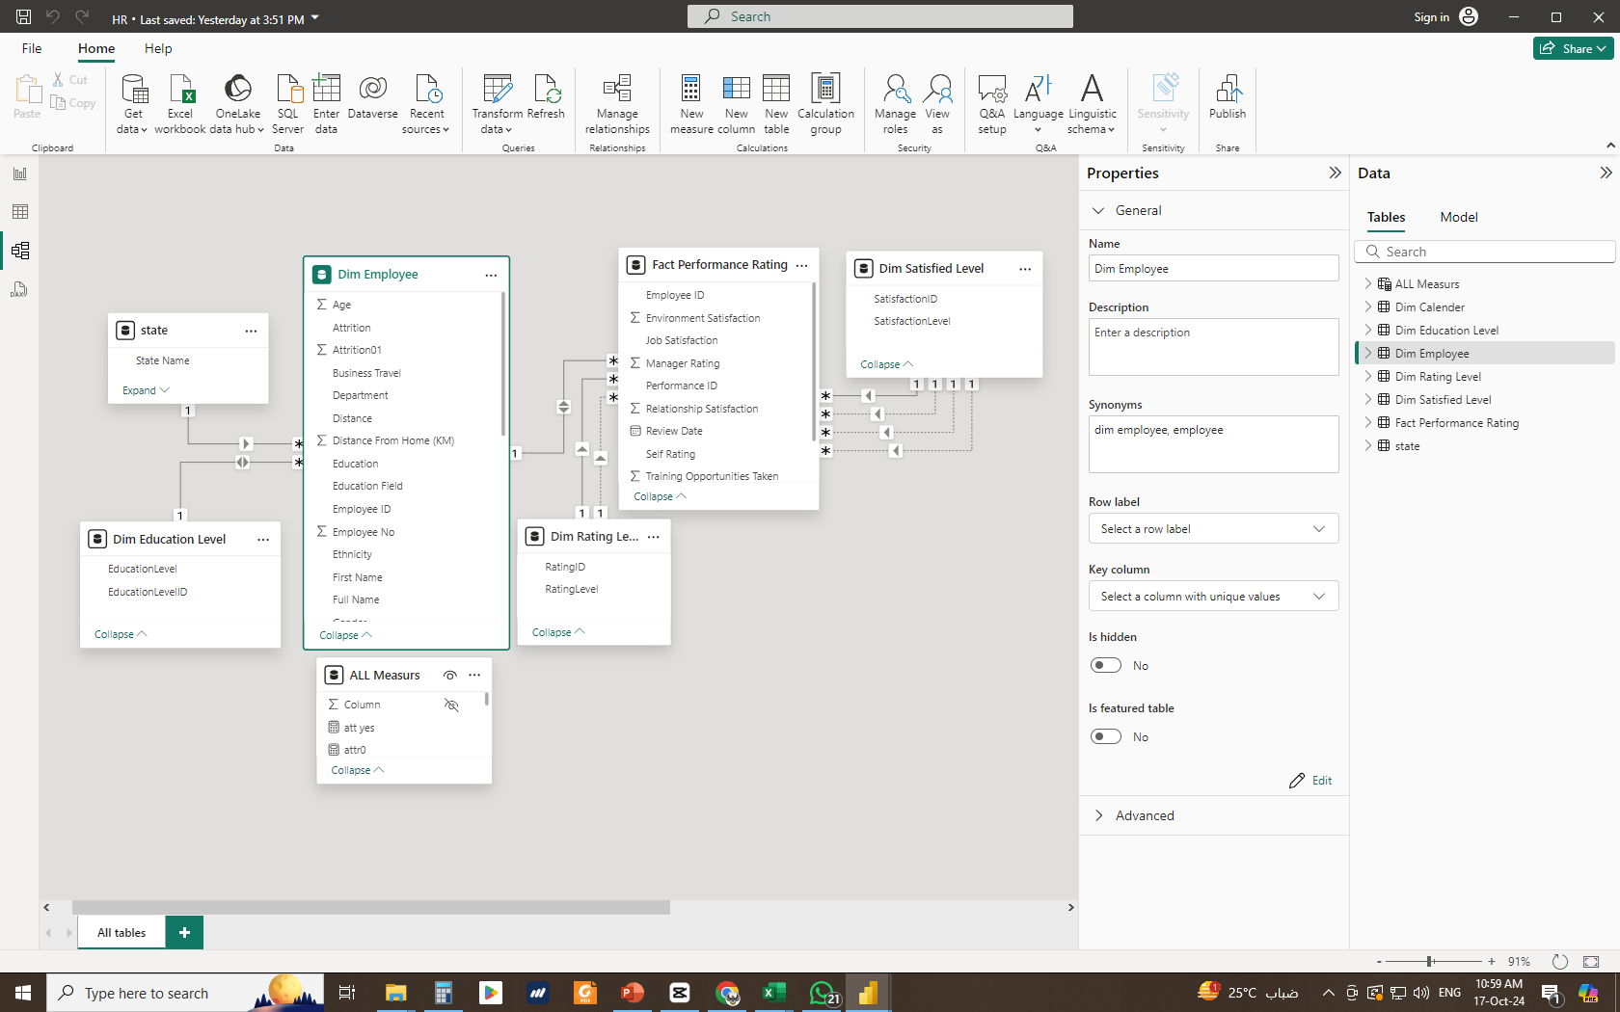

Attrition
Performance
Overview
HR
Analytics
Project steps
Data Modeling:- Building the data model:
Connect the Dim Education Level table to the Dim Employee table
Connect Fact Performance Rating table columns (Environment Satisfaction, Job Satisfaction, Relationship Satisfaction and Work Life Balance) to Dim Satisfaction Level table and use Environment Satisfaction as the active connection.
Connect Fact Performance Rating table columns (Self Rating, Manager Rating) to Dim Rating Level and use the Self Rating column as the active connection
Data Exploration
Data Cleaning
Data Modeling
Data Analysis
Dashboard

Slide 8
Attrition
Performance
Overview
HR
Analytics
Project steps
  Data Modeling
Data Exploration
Data Cleaning
Data Modeling
Data Analysis
Dashboard

Slide 9

Attrition
HR
Analytics
Data Analysis & Visualization
Home screen
Performance
Overview
Dashboard

Slide 10
Attrition
HR
Analytics
Data Analysis & Visualization
Home screen
Performance
Overview
Dashboard

Slide 11
Attrition
HR
Analytics
Data Analysis & Visualization
Home screen
Performance
Overview
Dashboard

Slide 12
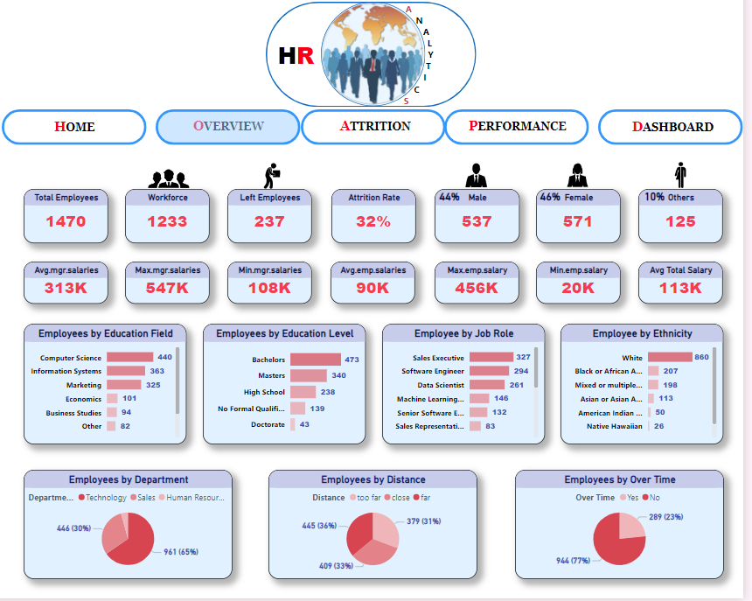
Attrition
HR
Analytics
Data Analysis & Visualization
Home screen
Performance
Overview
Dashboard

Slide 13
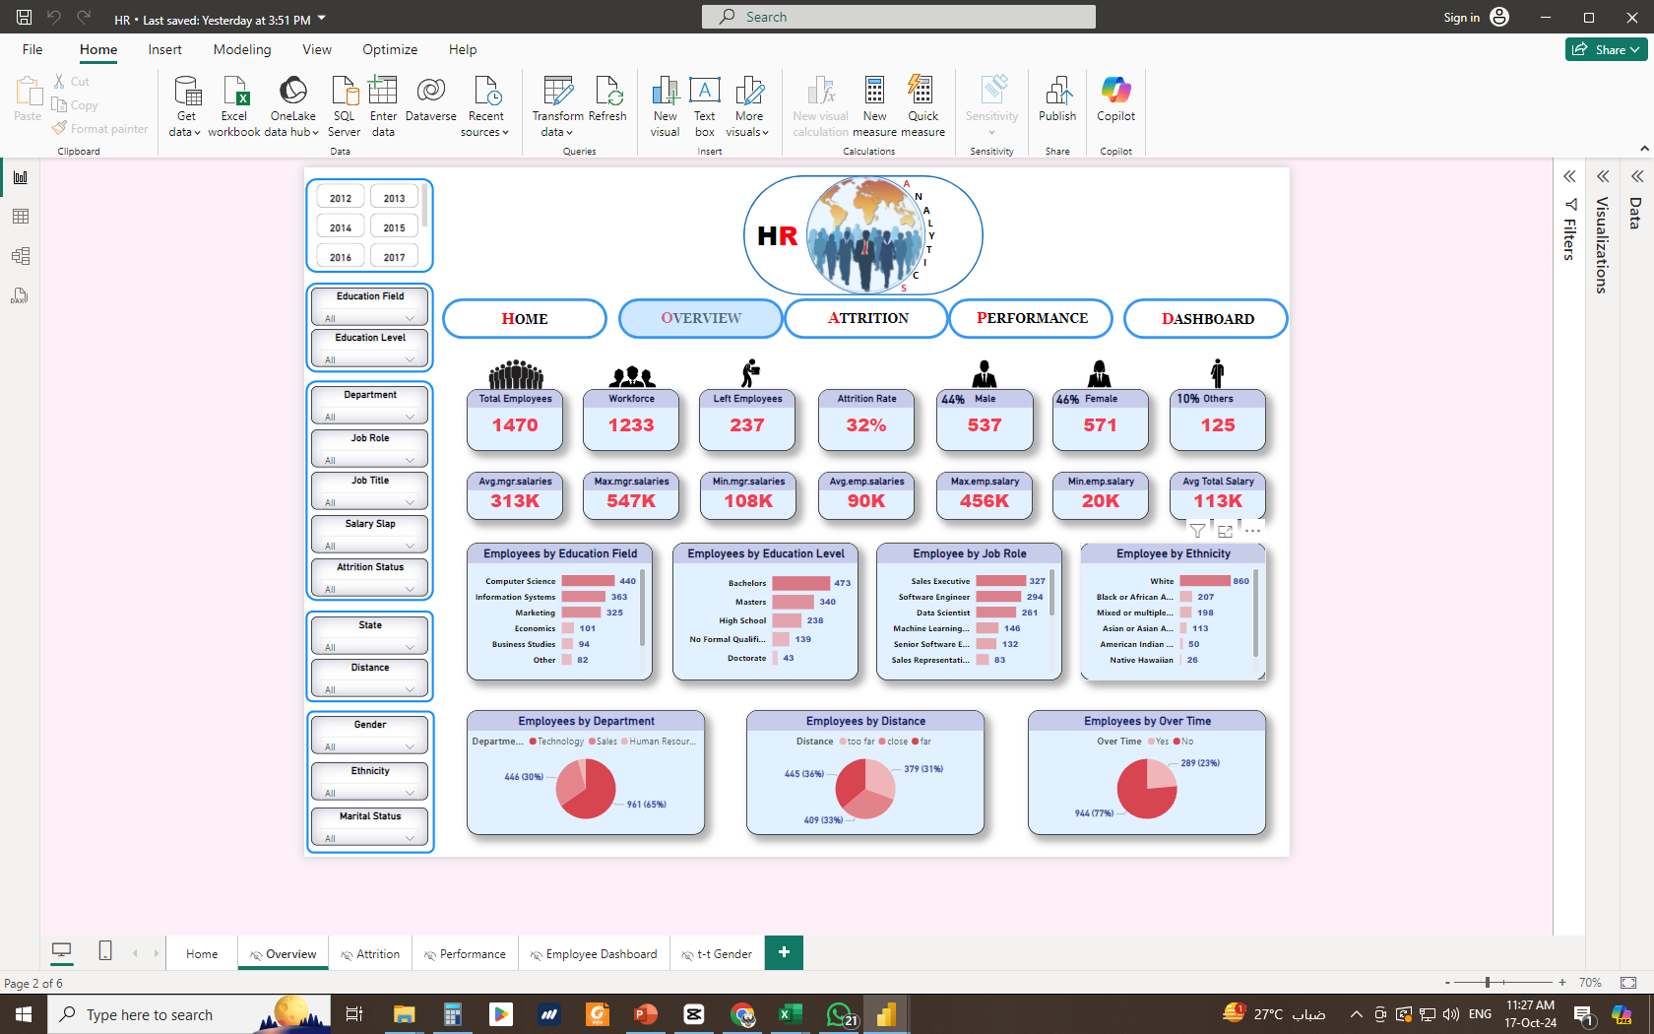

Attrition
HR
Analytics
Data Analysis & Visualization
Home screen
Performance
Overview
Dashboard

Slide 14
Overview
A general overview of employee data, including:
Total number of employees registered in the database
Number of employees currently working in the company
Number of employees who have left the company
Employee attrition rate
Average salaries
Visual representations (charts) such as:
  Number of employees by educational field
  Number of employees by educational level
  Number of employees by job role
  Number of employees by ethnicity

Slide 15
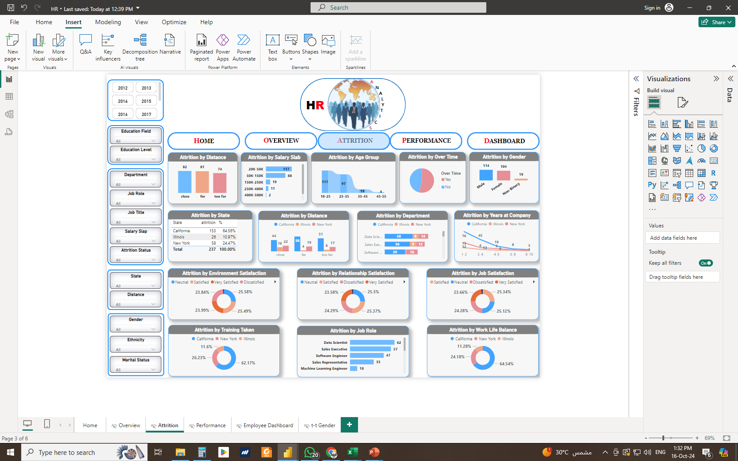
Attrition
A more in-depth examination of employee attrition, considering factors including:-
Distance from office
Salary Ranges
Age demographics, and gender
Years at Company
Over time
Department
Job Role

Slide 16
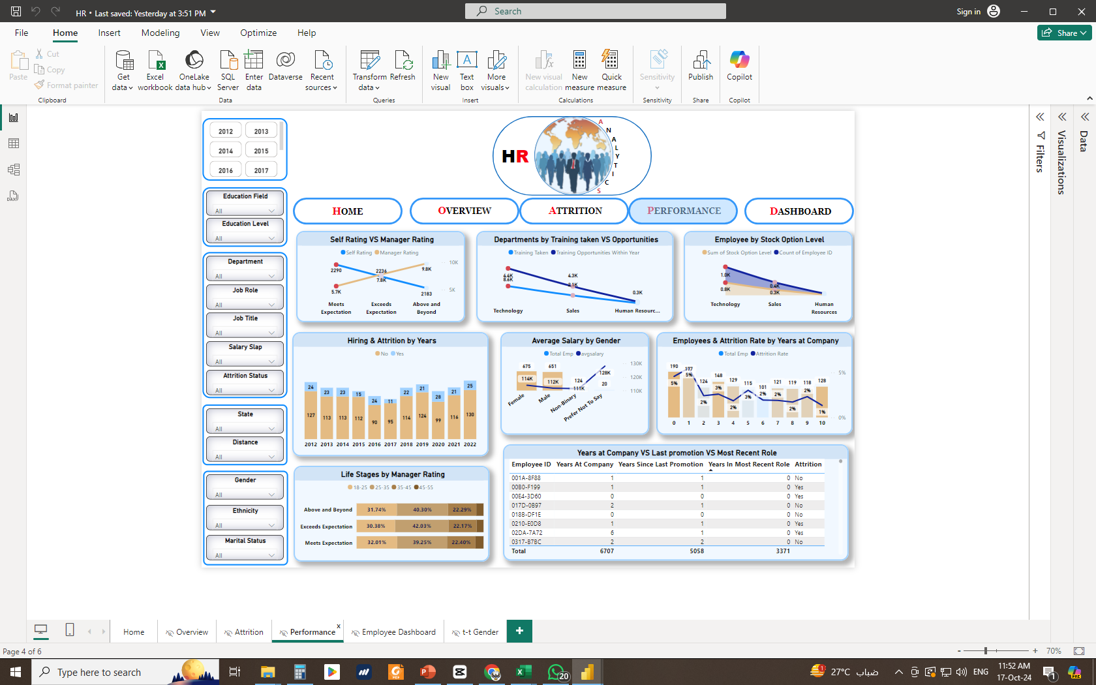
Performance
Employee Performance Analysis based on:-
Managers Rate, self-Rate
Training opportunities taken and available in different departments
Annual hiring and attrition rates, and average salaries by gender

Slide 17

Measures
Measures I created in All measures table
Total Emp = DISTINCTCOUNT('Dim Employee'[Employee ID]) this measure is to calculate the total no of employees located in the dataset
Total active Emp = CALCULATE(DISTINCTCOUNT('Dim Employee'[Employee ID]),'Dim Employee'[Attrition]="No") this measure is to calculate the total no of Active employees located in the dataset
att yes = CALCULATE(COUNT('Dim Employee'[Attrition]),'Dim Employee'[Attrition]="yes") this measure is to calculate the total no of employees Attrition located in the dataset
AVG TOTAL EMP = AVERAGE('Dim Employee'[Employee No]) this measure is to calculate the average no of all employees to use it in the next measure “attrition rate”
Attrition Rate = DIVIDE([attryes],[AVG TOTAL EMP]) this measure is to calculate attrition rate

Slide 18
Measures
Measures I created in All measures table
Emp Male = CALCULATE(COUNTROWS('Dim Employee'),KEEPFILTERS('Dim Employee'[Gender]="Male"),('Dim Employee'[Attrition]="No")) this measure is to calculate no of active male employees
Emp female & others = The same as previous for female and other genders
Male% = CALCULATE( DIVIDE([Emp Male],[Total active Emp])) this measure is to calculate percentage of active male employees
Female% = The same as previous for female and other genders
Turnover Rate = DIVIDE([att yes],[Total Emp]) this measure is to calculate turnover rate
manger avg salary = CALCULATE(AVERAGE('Dim Employee'[Salary]),'Dim Employee'[Attrition]="No",KEEPFILTERS('Dim Employee'[Manager or Not]="manager")) this measure is to calculate the average salary for managers

Slide 19
Thank You
by
Remon Atef

